Slide 1
Test Taking Strategies for the GED
Southern Union State Community College
Adult Education
FEATURE PRESENTATION
Notes:
‹#›
Fill in answers as we go

Slide 2
Can strategies really help me improve my score?
YES! EVERY QUESTION you get correct increases your score!
It also helps you conserve energy and not waste time. Let me explain…(keeps you from spinning)
Using test taking strategies is good practice for the GED AND other job related tests!
‹#›
Notes:
‹#›

Slide 3
Why should I bother with this?
They increase your score without even learning “new” stuff.
Learn more stuff PLUS get a few more right due to strategies and you are that much closer to passing!
I want you to PASS and earn your GED!
‹#›
Notes:
‹#›

Slide 4
Long term strategies: What should I do? (6 months to 2 days before exam)
Create a plan to improve your weakness
Don’t forget your strengths! Keep them fresh!
Follow that plan!
Adjust your plan as needed if your strengths or weaknesses change!
PRACTICE like its the real thing! Poor practice will create poor results.
‹#›

Slide 5
Short term strategies: What should I do? (day before exam)
Make sure you know EXACTLY where your testing center is located. Drive by there if you can.
Make sure you have proper identification, plenty of pencils, and the appropriate calculator. Don’t be afraid to call the day before and make sure you have everything! Those people know!
Get your high protein snacks and water/Gatorade bagged up for tomorrow.
Don’t cram! You don’t need to! However, you should review a couple of your weaknesses. DO NOT DO AN EXHAUSTIVE STUDY SESSION. Save that energy for the test!
Relax, watch a movie, take a walk, CHILL.
Get to bed just a little earlier than usual.
‹#›

Slide 6
Test Day: What do I do?
Wake up a little earlier than required. You don’t want to be in a rush or late!
DO NOT WEAR too comfortable clothes. You don’t want to make it easier to fall asleep or lose focus during the exam!
Don’t forget your ID, pencils, calculator, and snacks/drinks.
Arrive at the testing center 30 minutes before they ask you to!
Find the registration desk/area! Make sure you're at the right place. ASK someone!
‹#›

Slide 7
When you begin the test . . .
Do not spend too much time on hard questions
Try not to get upset when you cannot answer a hard question
Remember easy questions are not just at the beginning of the test
You are not expected to know all of the answers to all of the questions!
‹#›
Notes:
‹#›

Slide 8
During the test, you should
Make sure you know what to do before the test begins
Ask questions
Think about one item at a time
Read every word carefully
Know that there are easier questions paced throughout the test (easy first)
Answer every question & make intelligent guesses
Do Your Best on the Test!
‹#›
Notes:
‹#›

Slide 9
Reducing Test Taking Fears
Practice relaxation techniques: Recovery breathing (take a deep breath and exhale slowly). This pushes carbon dioxide out of your lungs and replaces it with energizing oxygen!
Mint candy/gum IF ALLOWED. If not allowed, eat/chew it as you can!
These general test strategies will help you feel more confident and less nervous
‹#›
Notes:
‹#›

Slide 10
Now…for the TEST STRATEGIES!
‹#›

Slide 11
Pacing . . . . .
Pace - to walk at a steady and consistent speed.
Don’t get hung up and waste time on the hard problems.
Find and answer all the “easy” questions first.
This will give you more time for the “hard” questions.
DO NOT “finish early.” Use EVERY MINUTE. Go back and review.
‹#›
Notes:
‹#›

Slide 12
example . . .
You have 30 minutes to do 30 questions. How long for each question?
What if the first ten were EASY? Should your strategy change?
‹#›
Notes:
‹#›

Slide 13
2. Following Directions . . .
Always listen to the directions given by the teacher
Read the directions on the test
Ask the teacher if you do not understand the directions
‹#›
Notes:
‹#›

Slide 14
Special words
Pay special attention to words in answer choices such as: All, None, Must, Always, Never, Each, Every. These words signal absoluteness and often imply wrong answer choices
Watch statements that include qualifying words such as: Some, Generally, Sometimes, Usually, Frequently
These words are often used to throw you off track
‹#›
Notes:
‹#›

Slide 15
3. Skip Around . . . .
On some tests, questions are neatly ordered in terms of increasing level of difficulty
On others, the test makers alternate between easy and hard questions to motivate students to finish each question set
To skip around effectively, students must be able to diagnose when a question looks too hard or too time-consuming
‹#›
Notes:
‹#›

Slide 16
4. Elimination Strategy
If you can’t figure out which answer is correct, try ruling out answers that you know are wrong
On Math tests, rule out answers that are too big or too small...think about the question!
On Vocabulary and Reading tests, rule out answers that seem too extreme..think about the question!
If you have some knowledge, but are not sure, take your best guess. THERE’S NO PENALTY FOR GUESSING.
‹#›
Notes:
‹#›

Slide 17
5. Educated Guesses
Leaving an answer blank means you get NO chance of getting points
A random guess gives you a 1 in 4 chance of getting it right.
An educated guess, ruling out one or more wrong answers, increases your chances of guessing correctly from 1 in 3 or 1 in 2!
Educated guessing means using everything you know to attempt to answer the questions
‹#›
Notes:
‹#›

Slide 18
6. Graph, Chart, & Table Strategy
Understand what information is given and what information is asked for
Read all the titles, labels, and any other given information
Understand what the graph, chart, or table measures.
Look for a pattern, trend, or comparison in the graph or table
‹#›
Notes:
‹#›

Slide 19
example . . . .
T-Shirt sales at Smiths Station High School and Valley High School
 | White | Black | Gray | Blue
Smiths Station High School
Whole Sale | $7.00 | $7.25 | $7.00 | $7.00
Retail | $8.00 | $9.00 | $10.00 | $8.60
Valley High School
Whole Sale | $7.20 | $7.30 | $6.00 | $8.80
Retail | $8.60 | $8.00 | $8.00 | $9.50
Which school makes more money from the sale of gray shirts?
‹#›
Notes:
‹#›

Slide 20
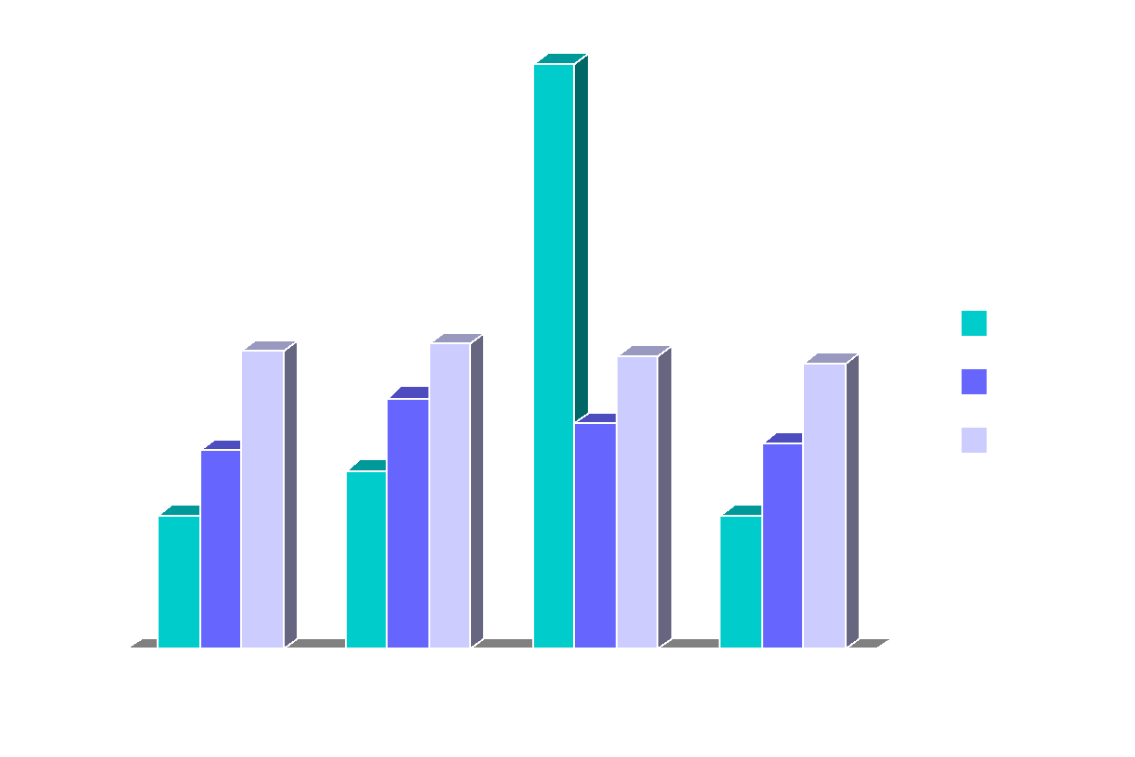
example #2 . . . .
Wal-Mart Earnings- 2006
What is the title of the graph?
Which quarter had the highest earnings?
Compare the shares sold in the 1st quarter and the 4th quarter
‹#›
Notes:
‹#›

Slide 21
7. Extended response
Read the question completely! Make sure you know exactly what it is asking.
Read article, then skim for info that can be used in your answer.
Use T-Chart to organize your answer.
Make sure you answer the question…

Slide 22
GOOD
LUCK!
(but you will not need it!)

